Slide 1
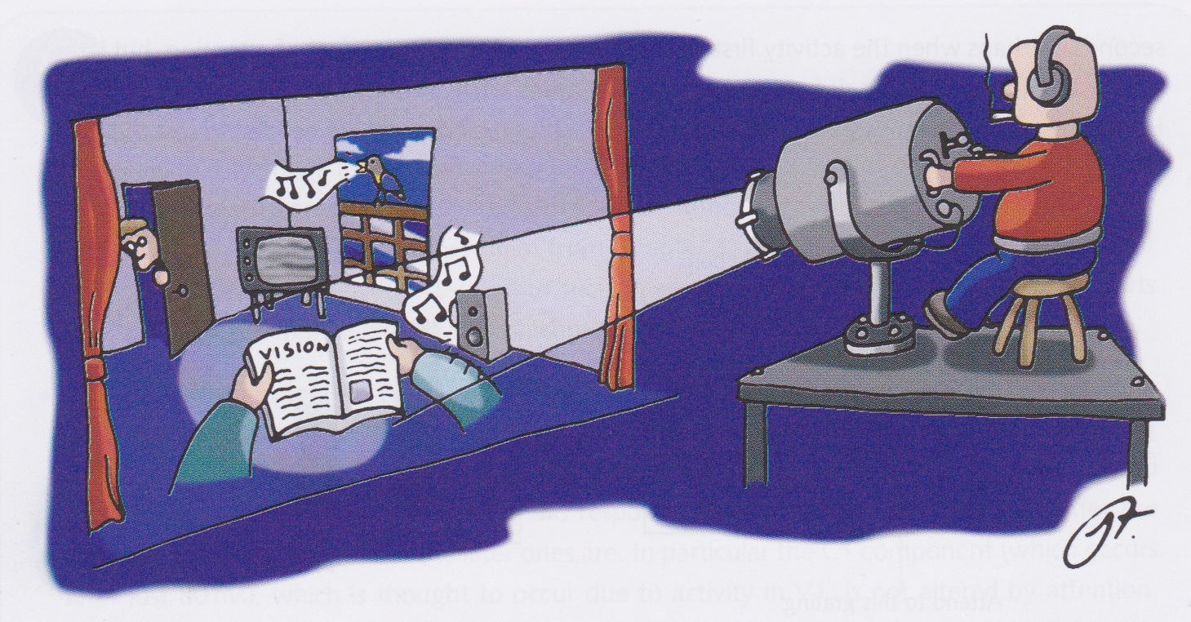
Attention and neglect
David Meredith
Aalborg University
dave@create.aau.dk

Slide 2
Source
This lecture is based on Chapter 9 of
Snowden, R., Thompson, P. & Troscianko, T. (2006). Basic Vision: An Introduction to Visual Perception. OUP. (ISBN: 978-0199286706)

Slide 3
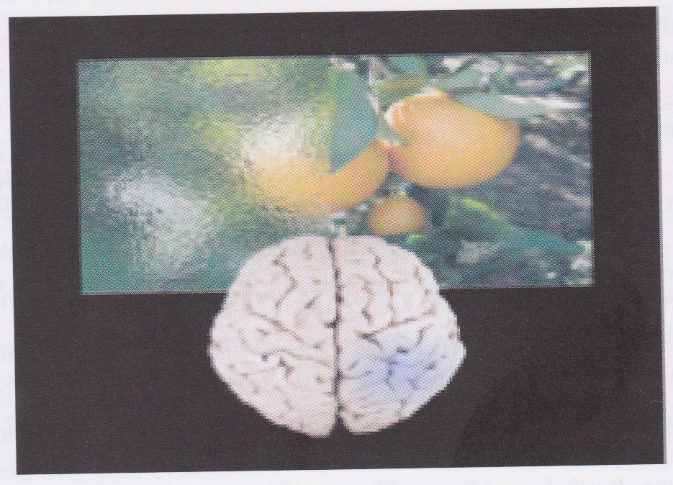
Hemispatial neglect
Schematic depiction of hemispatial neglect induced by repetitive transcranial magnetic stimulation (TMS)

Slide 4
Attention
“A flash of lightning by night, the report of a firearm, the sudden prick of a knife, or a violent internal pain, all these for the moment so occupy our notice that everything else becomes feeble or is banished.”
From p. 306 of:
Bradley, F. H. (1886). Is there any special activity of attention? Mind, Vol. 11, No. 43, pp. 305-323.

Slide 5
Introduction
When you focus your attention on a task, you don’t (consciously) notice other things that are going on around you
When you stop attending to the task, you suddenly become aware of noises and activity around you
Attention filters out unnecessary information and frees resources so they can be dedicated to the task at hand
What is filtered out? How is it filtered? Where does this filtering take place? What exactly are the “resources” that are freed up?

Slide 6
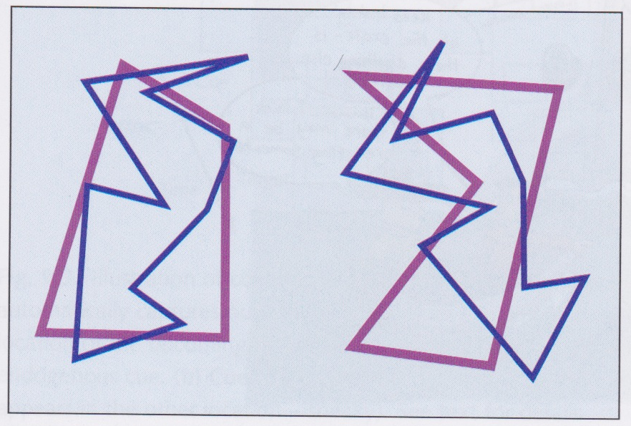
Attention
Decide whether the dark blue shapes on the left are the same
The purple shapes are there to make it harder!

Slide 7
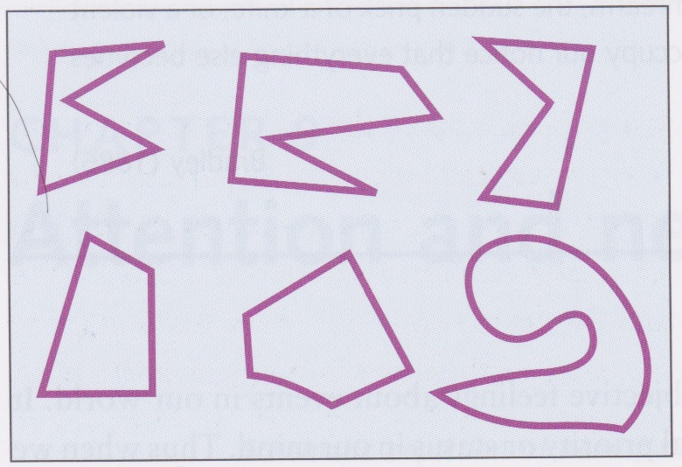
Attention
Which of the purple shapes on the left were present in the figures on the previous slide?

Slide 8
Attention
Hard to remember purple shapes because your attention was drawn away from them by the instructions
Tells us that vision is an active process:
Just because your eyes are facing in a particular direction doesn’t mean you’re seeing what’s there
Need to put some kind of ‘effort’ into processing the object
When we change our focus of (visual) attention, the eyes move so that the attended object projects onto the fovea – overt attention

Slide 9
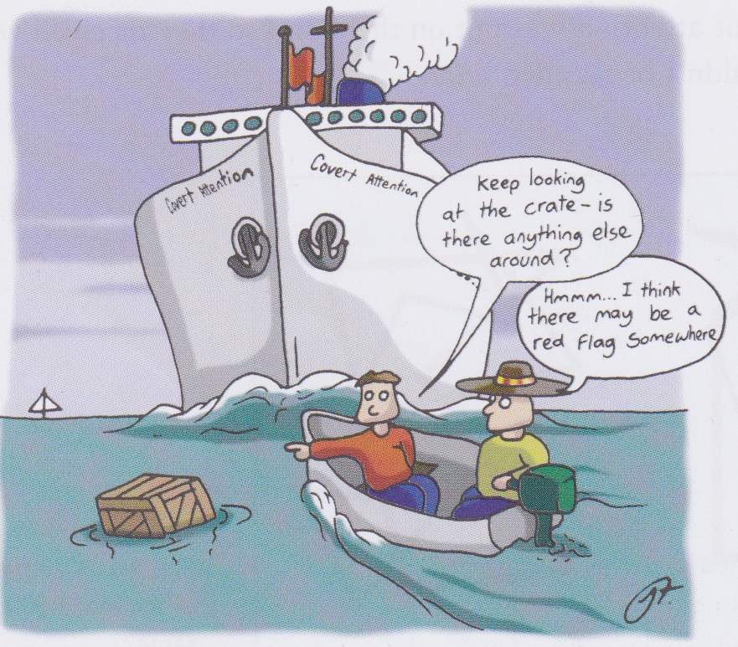
Vision and attention
What are the differences between our vision with attention and vision when our attention is elsewhere?
How do we decide what we should be paying attention to?

Slide 10
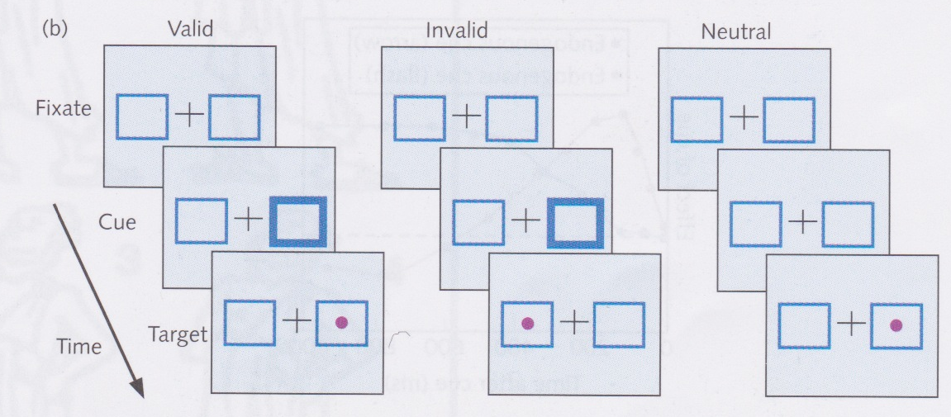
Moving attention
Covert cueing paradigm
Attention drawn to a particular part of the visual field by a cue
Target presented either in cued part of the field or another part of the field
Performance at the cued location (valid trials) compared with performance at the uncued location (invalid trials)
Can also have neutral trials where there is no cue
Can measure benefits and costs of attention
Benefits: compare valid with neutral trials
Costs: compare invalid with neutral trials

Slide 11
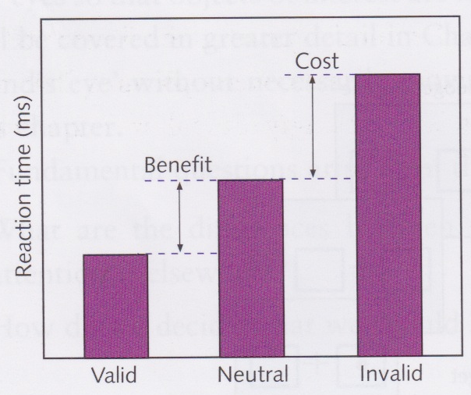
Typical results of cueing paradigm experiments
Reaction time usually longer for invalid trials than neutral trials
Cost of attention
Reaction time usually shorter for valid trials than neutral trials
Benefit of attention

Slide 12
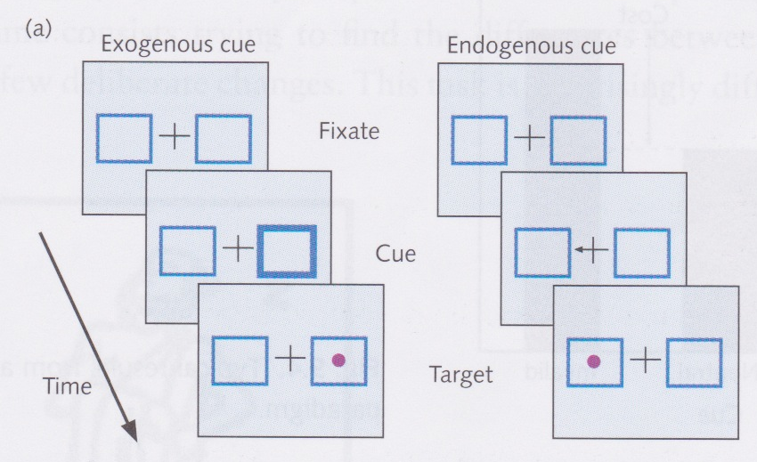
Exogenous and endogenous cues
Endogenous cue
You consciously direct your attention to the cued location
“Top-down”, slow, sustained and requires conscious effort
Exogenous cue
Your attention is grabbed by an unexpected and interesting event
“Bottom-up”, fast, transient and automatic
Can even be the offset of something
e.g., a clock stops ticking

Slide 13
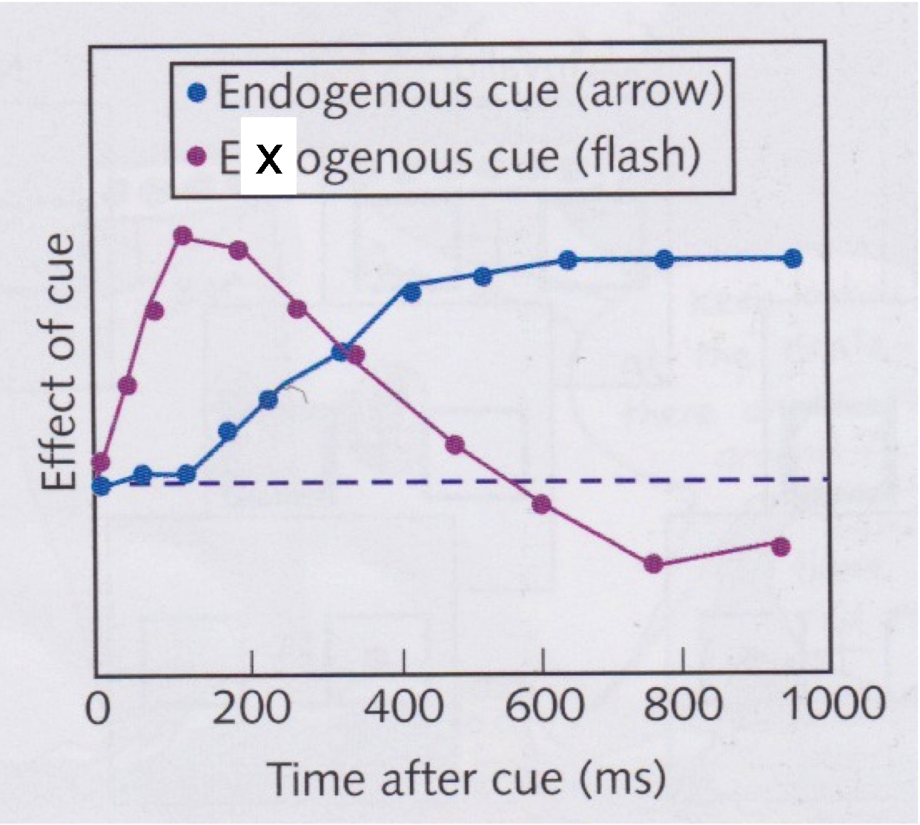
Effects of endogenous and exogenous cues
Exogenous cue (pink line) grabs attention quickly but effects drops off quickly and can even hinder performance after about 600ms (inhibition of return)
Endogenous cue (blue line) is slower to take effect but can last longer

Slide 14
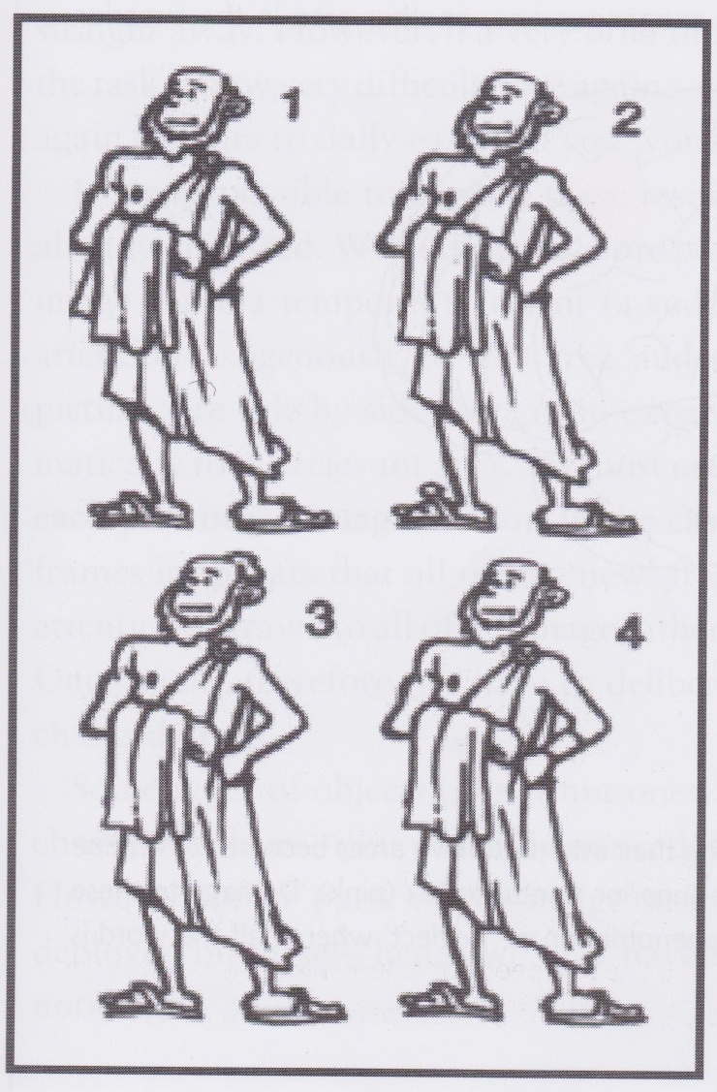
Change blindness
Can you spot the differences between these pictures?
Quite hard to do this to start with, but once you’ve found the differences, it’s hard to see why you found it so difficult

Slide 15
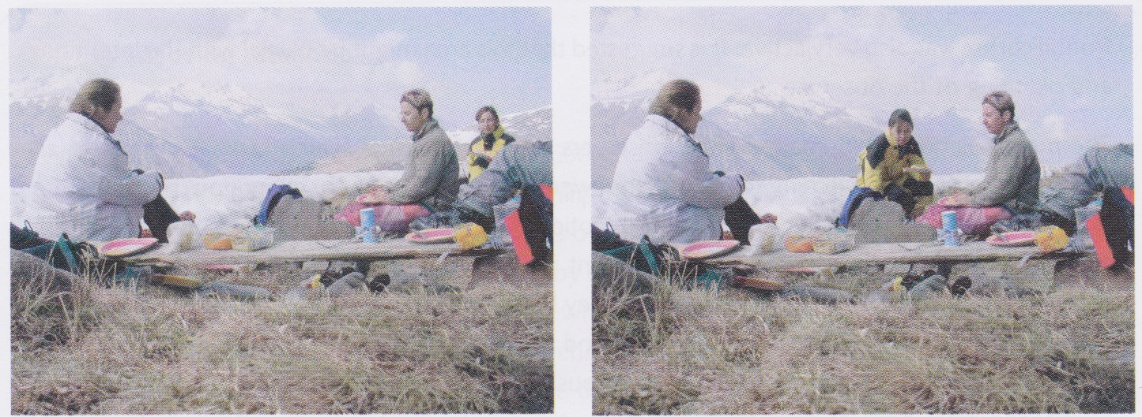
Change blindness
Quite hard to tell the difference between these two pictures
When pictures presented one after the other in quick succession, it is easy to tell the difference between them
If there is a short gap between the presentations, it becomes quite difficult again

Slide 16
Pictures presented with a gap

Slide 18
Pictures presented with a gap

Slide 19
Pictures presented with no gap

Slide 20
Pictures presented with no gap

Slide 21
Change blindness
When images presented in quick succession, differences cause a temporal transient that draws attention to those parts of the image that have changed
When pictures presented side-by-side, no exogenous cue, so attention not drawn to parts that are different
When there is a gap, the whole image is new after the blank screen, so attention not drawn to any particular part of the image

Slide 22
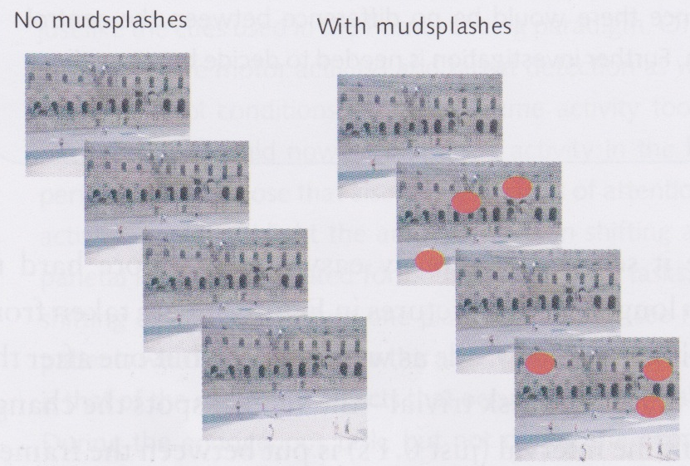
Mud splash experiment
Can draw observer’s attention away from the changes to be observed by introducing irrelevant, distracting transient exogenous cues
Natural interruptions like blinking or saccades can act like mud splashes and distract us from changes in the scene

Slide 23
We only know about what we’re looking at
Suggests that we know remarkably little about what’s going on around us
Basically we only know about what we’re attending to
Feels counter-intuitive: we feel as though we have a pretty good idea of, for example, what is happening in our peripheral vision

Slide 24
Fixate on the cross in the middle

Slide 25
What colour was the circle at the indicated position?

Slide 26
How do we know where to look next?
We only know about a tiny bit of the world at any time, but can move spotlight of attention to anywhere we like
How do we know where to move the spotlight of attention if we don’t know anything about what we’re not looking directly at?
Clearly some processing must be going on in the periphery, but what do we know about this?
One theory is that the unattended parts of the scene are encoded as unintegrated features

Slide 27
The world is fairly stable
If we don’t know much about what’s going on around us, why don’t we make terrible mistakes all the time?
Because the world around us doesn’t change very quickly – things don’t disappear in the blink of an eye
if it did, we would make lots of mistakes!
Typically fast changes are accompanied by sudden noises or movement (exogenous cues) which attract our attention
Magicians take advantage of this to distract us

Slide 28
Moving attention
Where does attention happen in the brain?
Corbetta et al (1993) used PET to highlight areas that are active when attention is being shifted
Subjects had to detect targets appearing at predictable positions in a sequence, sometimes the target would appear in an unpredictable place
Requires lots of endogenous attention
To test exogenous attention, stimuli flashed up in peripheral locations

Slide 29
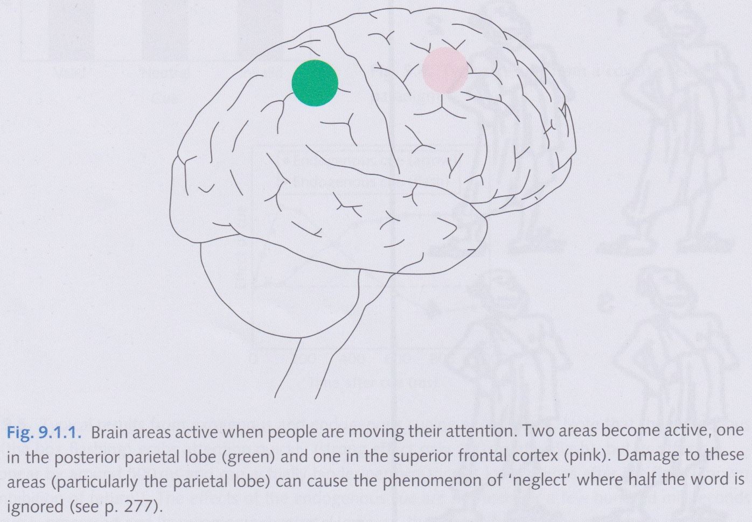
Moving attention
Corbetta et al (1993) found area in parietal lobe that is activated during attention shifting tasks
If parietal lobe damaged in this area, results in neglect of objects in contralateral side
During endogenous task, area in frontal cortex also activated (area associated with planning and intentions)

Slide 30
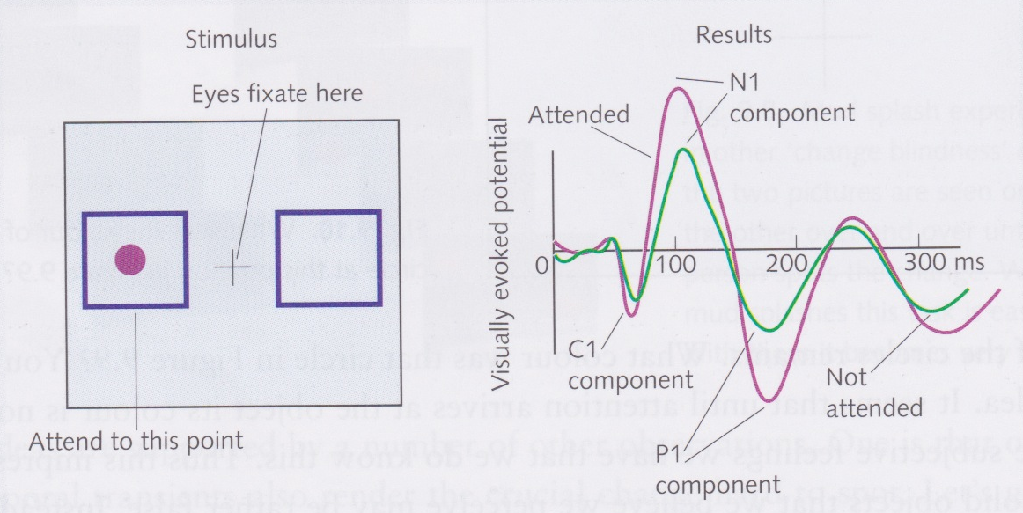
Where does attention have its effect?
Compare VEPs when person attending and not attending
Early components in response not affected
Correspond to early stages of visual system up to and including V1
Later components are increased, corresponding to extra-striate areas

Slide 31
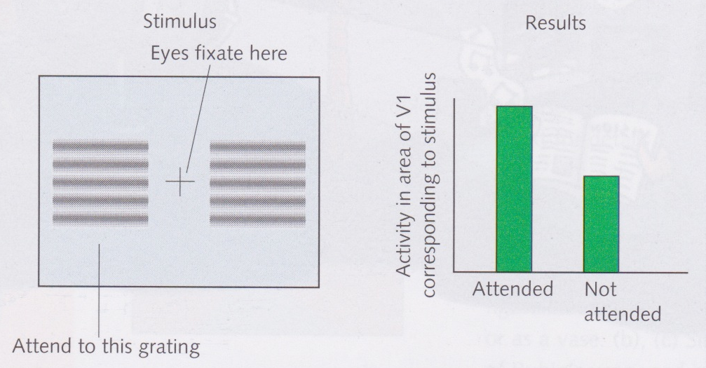
Effect of attention on V1
fMRI also used to show that extrastriate areas affected by attention
Also showed that activity in V1 increased with attention when looking at a grating
So attention also affects V1
Differerence in results between VEP and fMRI could be due to longer period over which fMRI measures activity
V1 might not be affected immediately, only after feedback from extrastriate areas

Slide 32
The spotlight of attention
How fast does it move?
Does it pass through all intermediate locations when moving from one point of interest to another?
Can its size be varied like a zoom lens?
Can we have more than one spotlight?

Slide 33
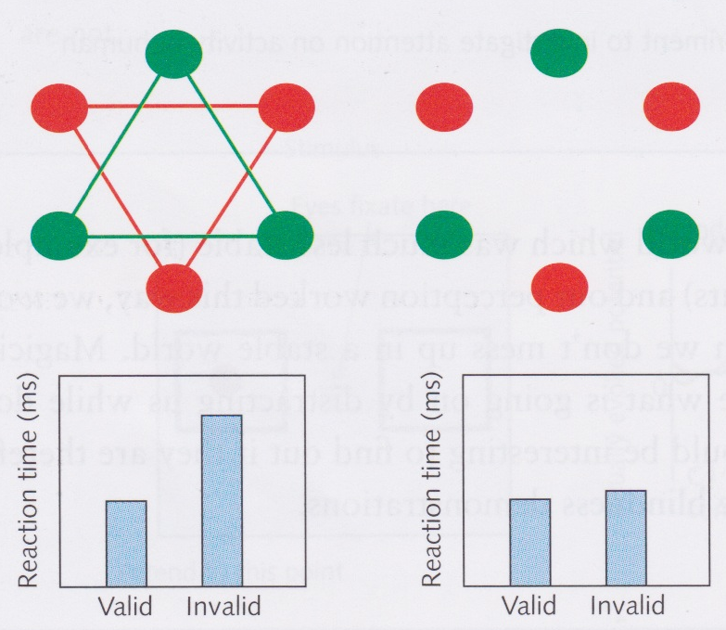
Objects or areas of the field?
Do we attend to objects or to parts of the visual field?
If red and green triangles are drawn, then can attend to just green triangle even though it occupies the same space as the red triangle
When lines removed, subjects no faster on green circles than red circles
So at least some aspects of attention are object-based, not space-based

Slide 34
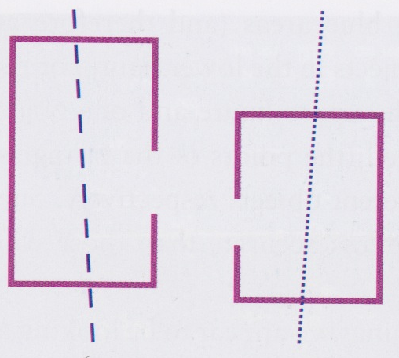
Object-based attention
Figure flashed briefly consisting of a box with a gap and a line across it
Then had to answer 2 of 4 possible questions:
Is the box large or small?
Is the gap on the box on the left or the right?
Is the line tilted to the left or the right?
Is the line dashed or dotted?
Subjects performed well if both questions came from one object, but not so well if they came from different objects

Slide 35
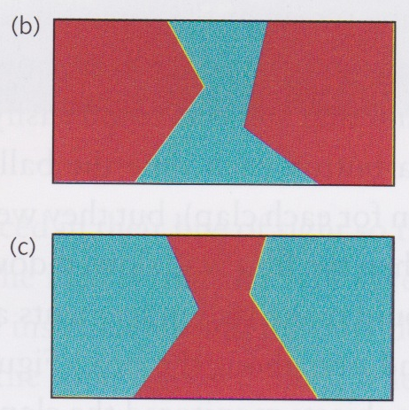
Object recognition
How do we identify objects in the first place?
Do you see two faces or a vase?
Can you alternate between the two?
Subjects asked to say whether angle on left is larger or smaller than angle on right
Either told to attend to blue areas or to red areas
Tend to be less accurate if consider points to be on different objects

Slide 36
Watch this
http://www.youtube.com/watch?v=vJG698U2Mvo

Slide 37
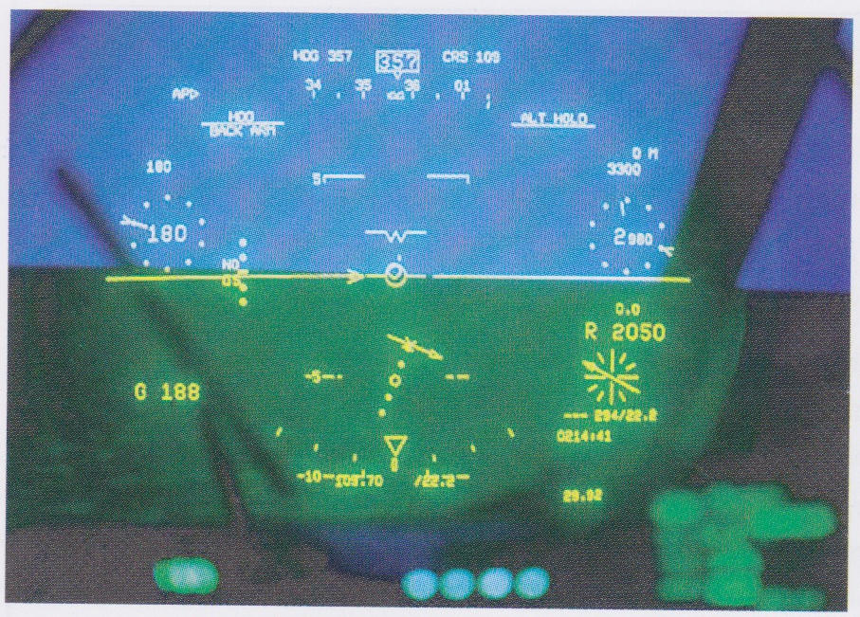
Head-up displays
Head-up display allows pilot to monitor controls without taking eyes off the scene in front
Or does it?
Told to land plane in a simulation under cloudy conditions and abort landing if there were problems
Subjects better at spotting runway with head-up display
But much slower at noticing unexpected events
e.g., another plane approaching on the runway!
Never as good at noticing things that are unexpected

Slide 38
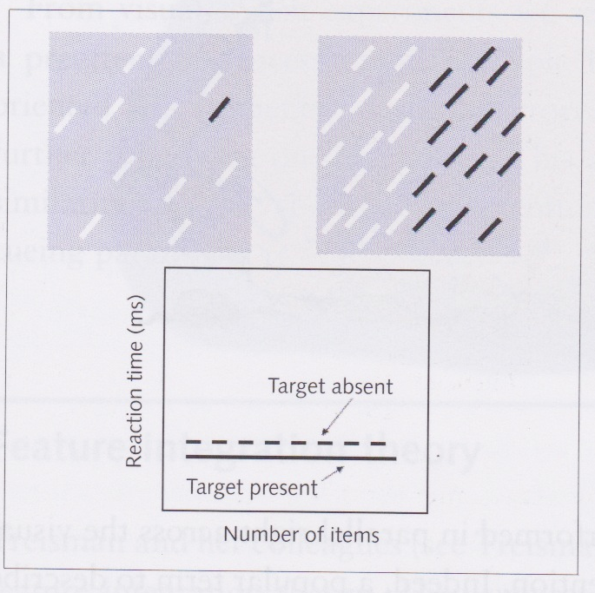
Parallel search
Look at image at top left – black item pops out
Time taken to find such an item is independent of number of distractor items
“constant-time”, “parallel” process
called preattentive search or parallel search
Occurs when there are differences in
orientation, colour, movement, size and depth
These processes also seem to allow for instantaneous separation of figure from ground (see top right figure)

Slide 39
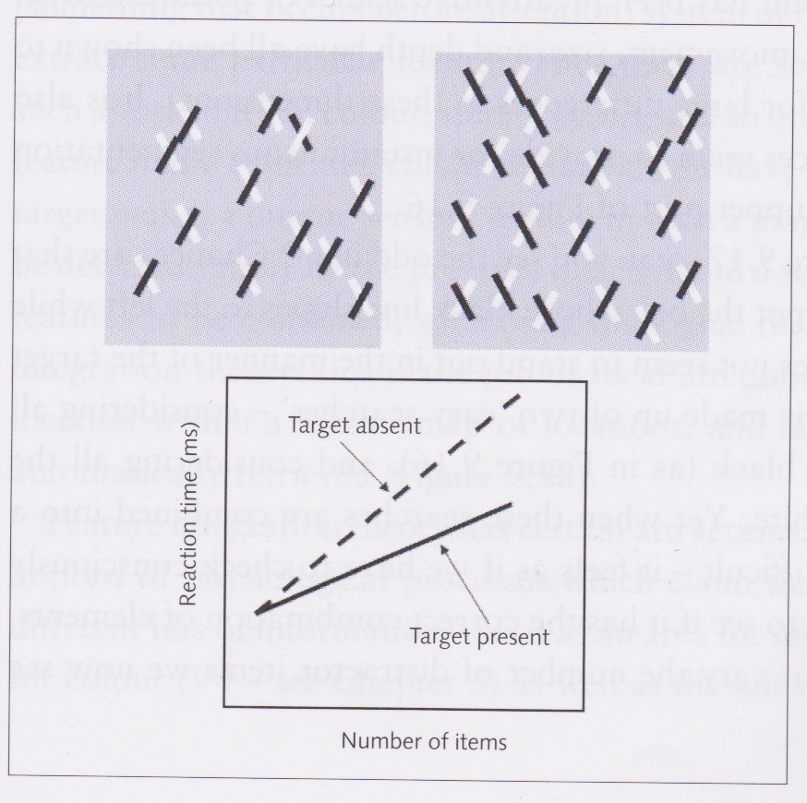
Serial conjunction search
In figure at top left, need to struggle to find “odd-man-out”
Made up of two “easy” searches:
one left-sloping line is black
one right-sloping line is white
But when combined into a conjunction search task becomes hard
have to consciously check each object and compare with others
When number of distractors increases, so does time for finding “odd-man-out”

Slide 40
Conjunction search
On average, twice as fast at finding object in conjunction search as determining that no odd object is present
Serial search that involves focal attention being paid to each object in turn
On average, if odd object present, then will find it after searching half of the objects present
To show that no odd object is present, must search through all objects

Slide 41
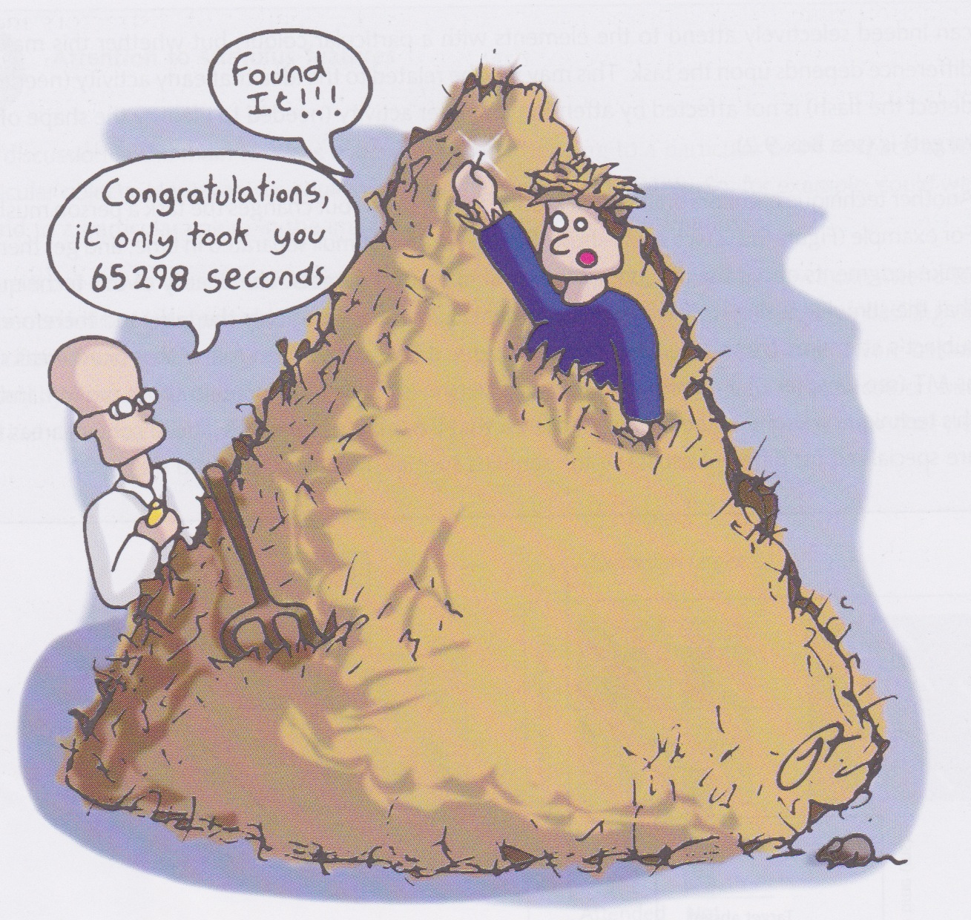
Visual search
Two mechanisms
Preattentive process that extracts simple features from the scene (e.g., colours, orientation)
Focal attention performs further processing on these items (cf. spotlight of attention)

Slide 42
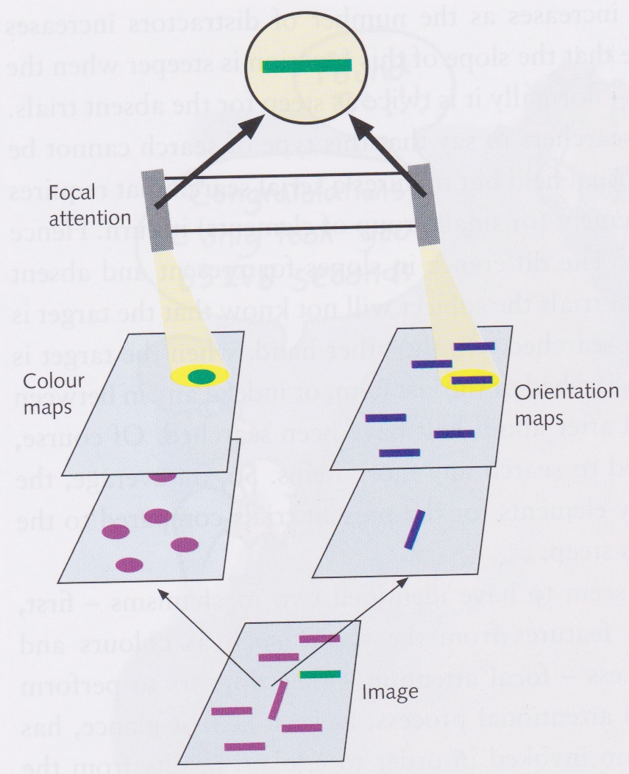
Feature integration theory
Treisman (1986) and her colleagues propose a feature integration theory in which features are extracted by a preattentive system of modules, each for finding a particular kind of feature
e.g., colour, orientation, depth
Each module has many feature maps, one for each different level of the feature
e.g., one for each colour in the colour module
A target that has a unique feature (e.g., the only green thing) produces highly localised activity in one map
Focal attention “glues” the maps together
selects a particular location in a master map that automatically retrieves all features at that location in all maps

Slide 43
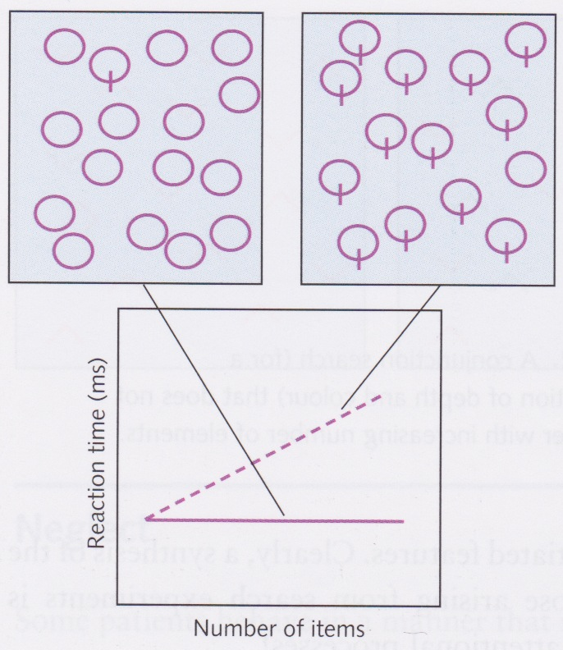
Feature integration theory
Fits with modular structure of the brain
e.g., MT for motion, V4 for colour, etc.
Fits with physiological properties of certain cells
e.g., orientation selectivity
Finding a circle in a field of lollipops is harder than finding a lollipop in a field of circles
Because odd-man-out is distinguished by having a simple feature rather than not having a particular feature
To find the circle in a field of lollipops, you have to check all the circles in the circle maps to see if there’s a corresponding “stick” in the stick map

Slide 44
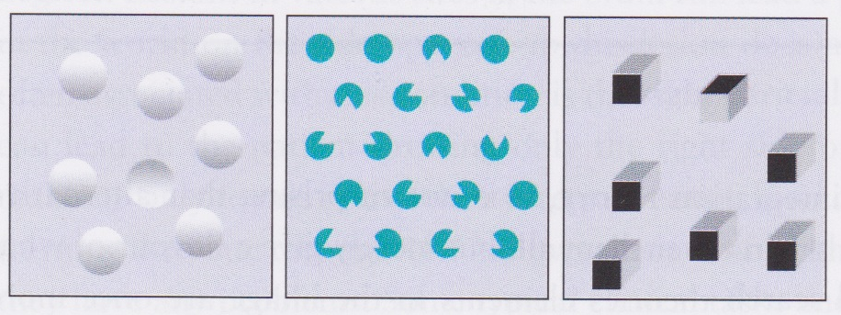
Problems with feature integration theory
List of “features” has had to steadily grow in order to account for observed effects
Some of these features seem to be quite complex (see above)
Some conjunction searches are “parallel” (i.e., constant-time)
e.g., if one feature is depth or motion – such features may segment the scene into “surfaces” allowing us to parallel search one surface at a time

Slide 45
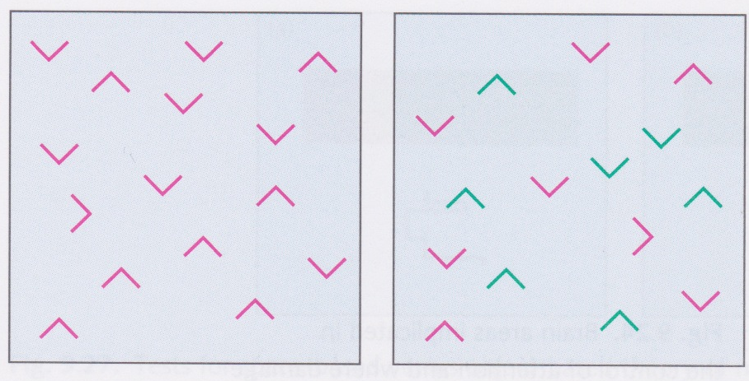
Guided search
Image again analysed into simple features
But then used to build a salience map which is independent of what actually caused the salience
Salience can be bottom-up...
e.g., due to rarity in field (single blue line in a field of red lines)
...or top-down
“Look for a blue line!”
Gives list of elements in order of salience
So parallel search is fast because the most salient objects are at the top of the list
In serial search, target is not most salient element and need to look further down in list
Leaves many things unexplained e.g., how is sorting done?
Look for a purple > in images above – quicker at right because can discount green distractors

Slide 46
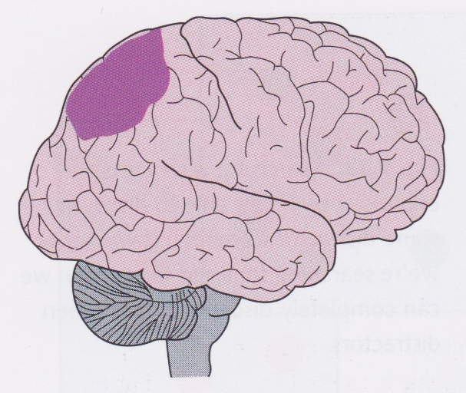
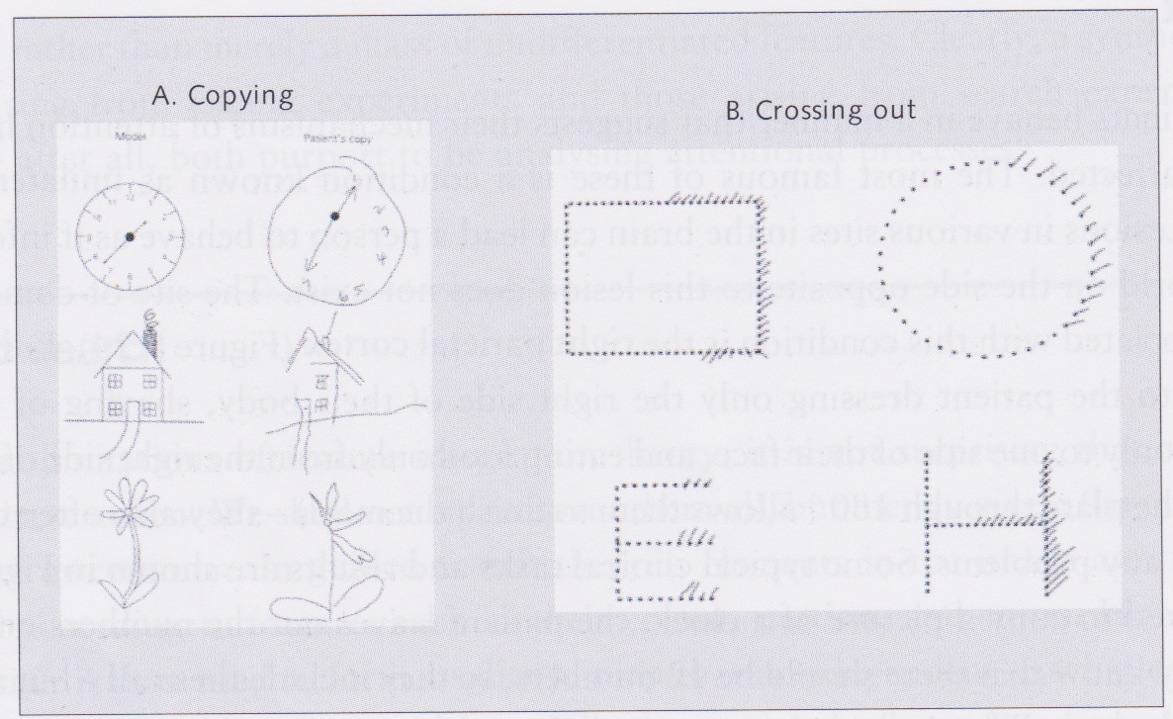
Unilateral visual neglect
If person has lesion in right parietal cortex, then behaves as though he gets no information from the left visual field
might shave or apply make up only to right side
might only eat food from right side of plate
Commonly deny they have any problems
Extreme neglect is rare and tends to fade with time
More common is extinction
if a single element presented on the left, the no problem
if elements presented on both sides, then only right-hand element reported

Slide 47
Is neglect object- or space-based?
In crossing-out task, subject crosses out rhs of each object
suggests that recognizes objects before neglect takes effect
However, could be that subject fixates each object separately, so could be space-based
Similarly, copying drawings must involve many fixations, so results are hard to interpet

Slide 48
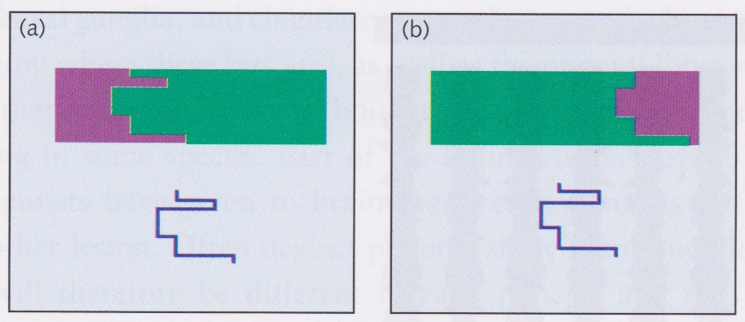
Is neglect object- or space-based?
Neglect patient has to identify whether target contour is same as boundary between regions
Purple region usually perceived as object
50% correct (chance level) when purple region on right (and boundary to left of object)
80% correct (same as normal people) when purple region on left (boundary on right of object)
So here neglect is clearly object-based

Slide 49
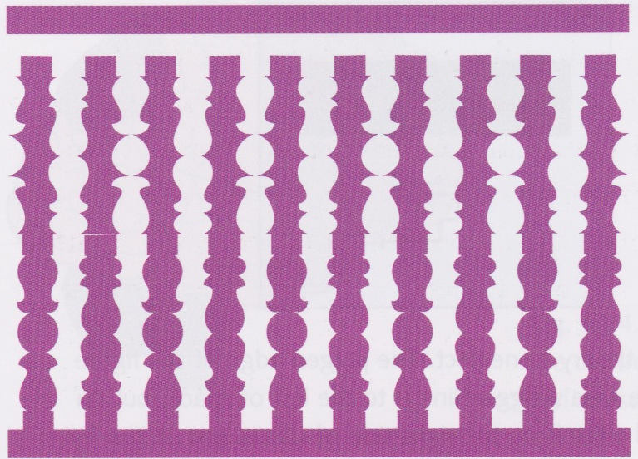
Symmetry cues in figure-ground perception
When look at top of figure, banisters look white, when look at bottom of figure, banisters look pink
This is due to symmetry
Neglect patient identifies figure in such images just as a normal person does
So must be processing both sides of each “banister”
However, if only one banister is presented, patient performs at chance level

